Slide 1

Unlocking Customer Insights
This project delves into customer shopping behavior, analyzing transactional data to uncover spending patterns, product preferences, and subscription trends. Our goal is to guide strategic business decisions with actionable insights.
M.H.R. Perera | Customer Shopping Behavior Analysis

Slide 2




Project Overview: Analyzing Shopping Behavior
Transactional Data
Key Insights
Strategic Guidance
Analysis of 3,900 purchases across diverse product categories.
Uncovering spending patterns, customer segments, and product preferences.
Informing business decisions through data-driven recommendations.
M.H.R. Perera | Customer Shopping Behavior Analysis

Slide 3

Dataset at a Glance
Dataset Summary
Rows | 3900
Columns | 18
Missing Data | 37 values in Review Rating
Key Features
Customer Demographics: Age, Gender, Location, Subscription Status
Purchase Details: Item, Category, Amount, Season, Size, Color
Shopping Behavior: Discount, Promo Code, Previous Purchases, Frequency, Review Rating, Shipping Type
M.H.R. Perera | Customer Shopping Behavior Analysis

Slide 4
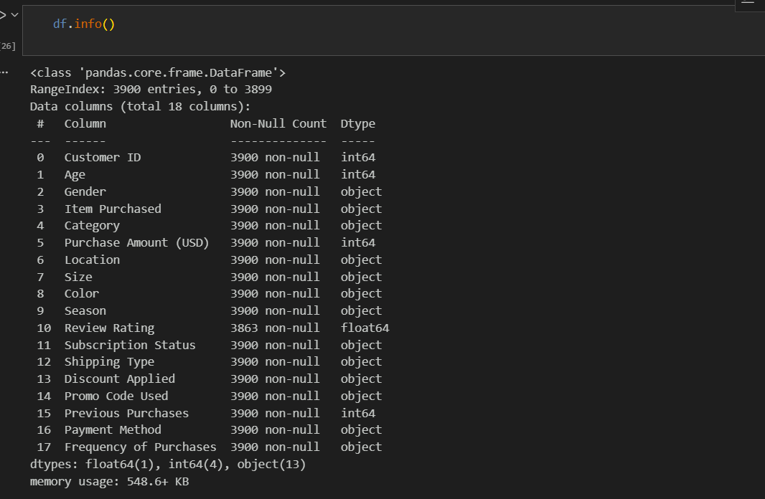
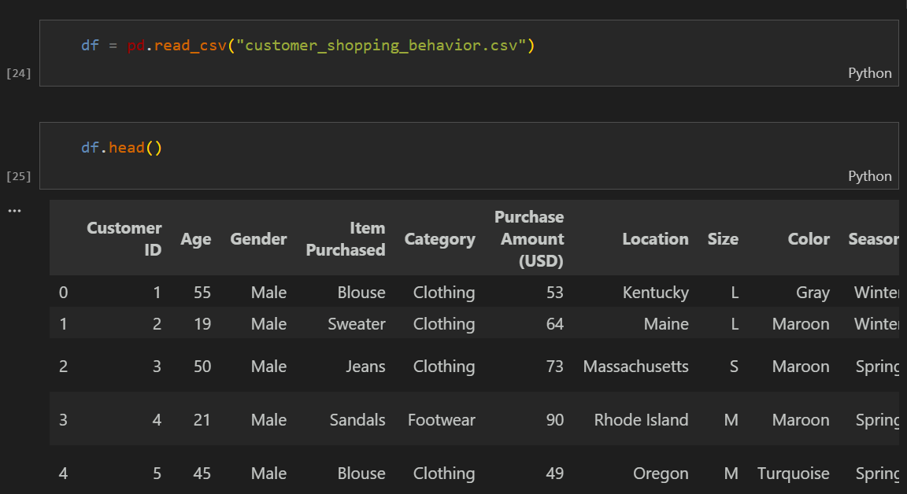
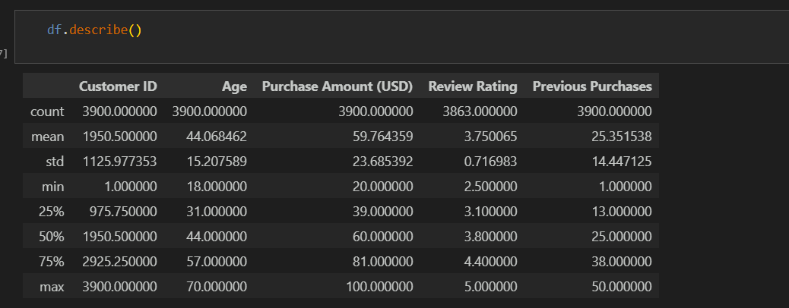
Exploratory Data Analysis: Python Workflow
Our data preparation and cleaning involved several crucial steps to ensure data quality and readiness for analysis.
01
02
Data Loading
Initial Exploration
Utilized pandas for efficient data ingestion.
Used df.info() and describe() for a quick overview.
M.H.R. Perera | Customer Shopping Behavior Analysis

Slide 5
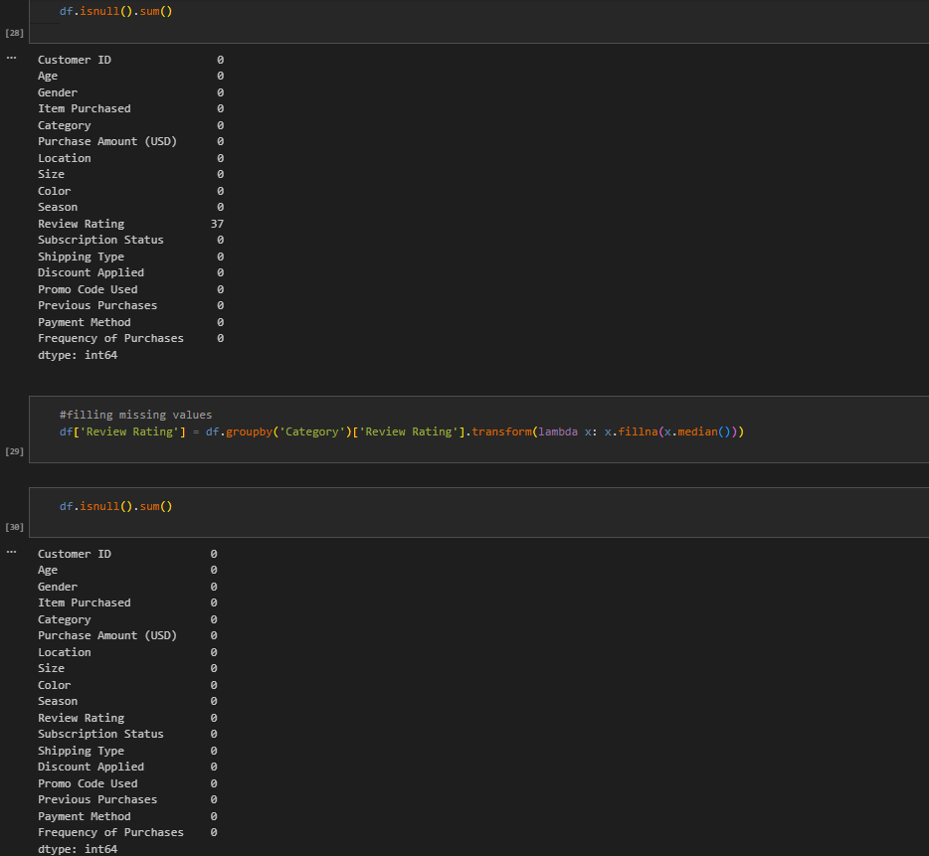
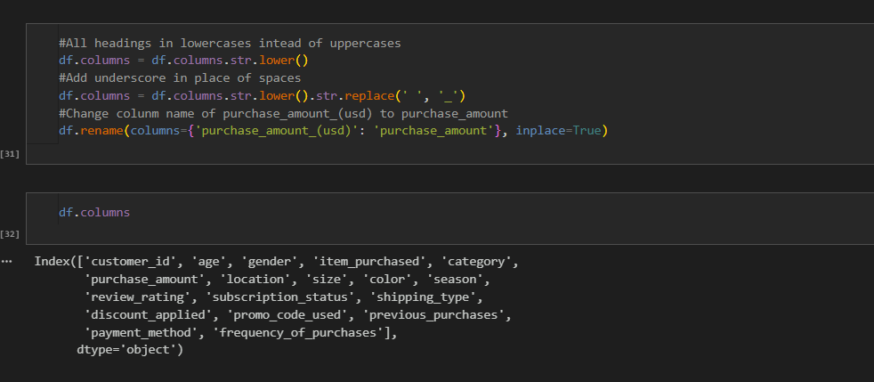
Exploratory Data Analysis: Python Workflow
03
04
Missing Data Handling
Column Standardization
Imputed missing 'Review Rating' values with the median per product category.
Renamed columns to 'snake_case' for consistency.
M.H.R. Perera | Customer Shopping Behavior Analysis

Slide 6
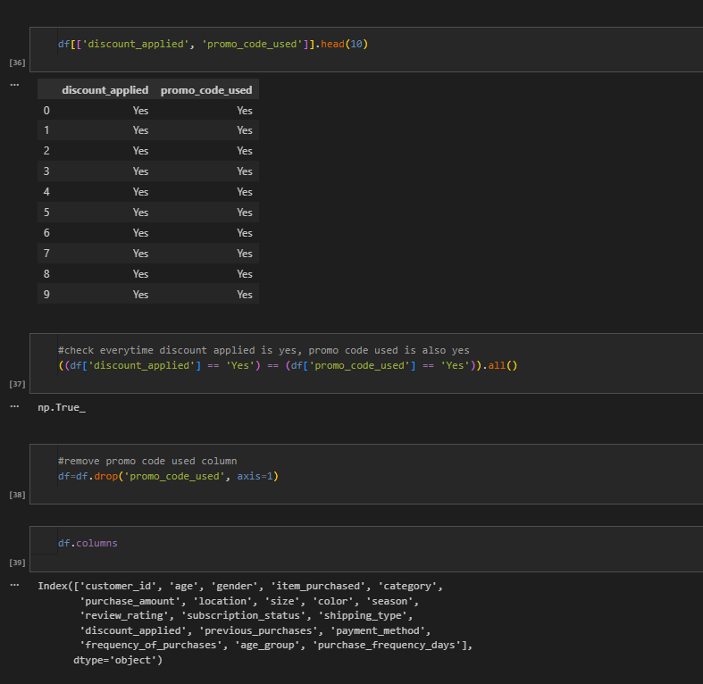
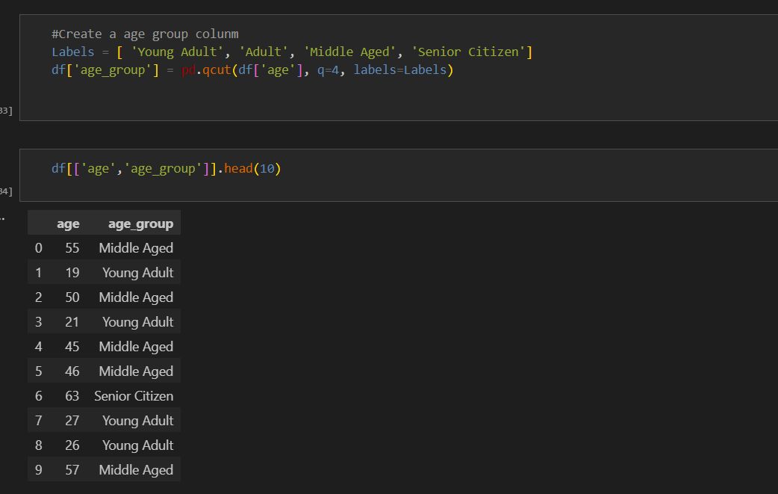
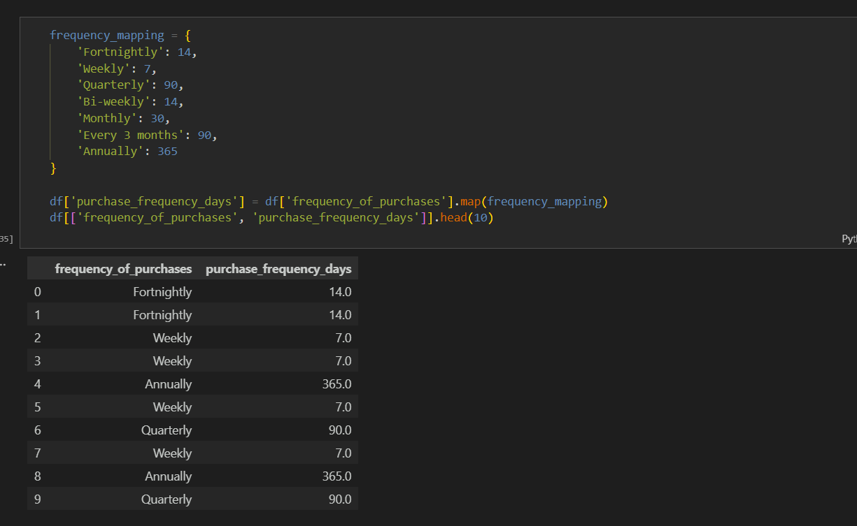
Exploratory Data Analysis: Python Workflow
05
06
Feature Engineering
Consistency Check
Created 'age_group' and 'purchase_frequency_days' for deeper insights.
Removed redundant 'promo_code_used' column.
M.H.R. Perera | Customer Shopping Behavior Analysis

Slide 7
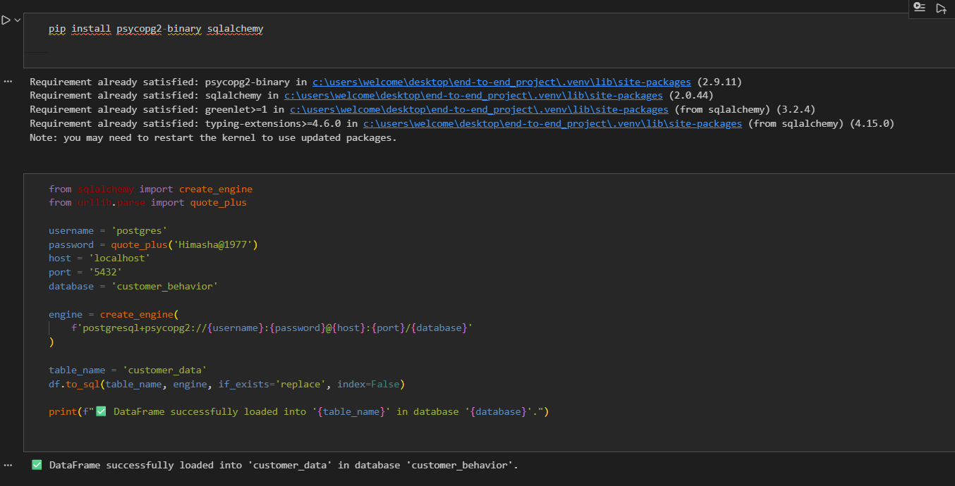
Exploratory Data Analysis: Python Workflow
07
Database Integration
Loaded the cleaned DataFrame into PostgreSQL for further analysis.
M.H.R. Perera | Customer Shopping Behavior Analysis

Slide 8

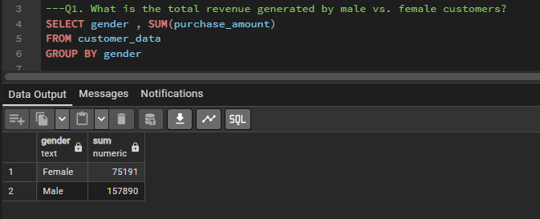
Key SQL Analysis: Business Transactions
SQL queries provided critical insights into various business aspects, from revenue distribution to product performance.
Revenue by Gender
Understanding spending disparities between genders.
M.H.R. Perera | Customer Shopping Behavior Analysis

Slide 9
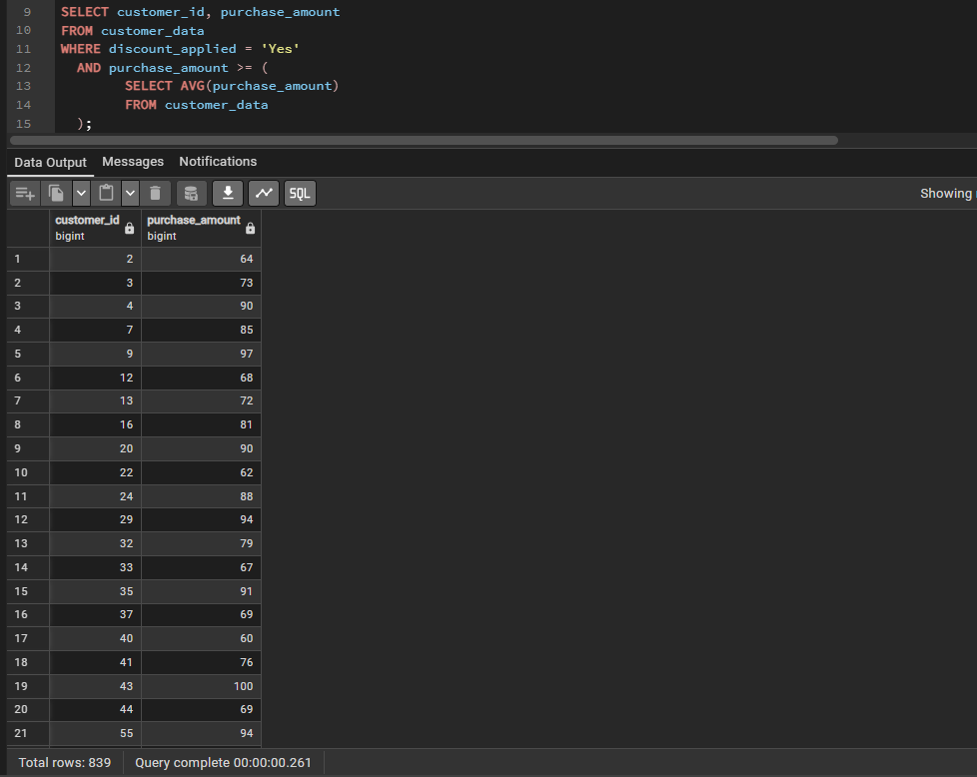
Key SQL Analysis: Business Transactions
High-Spending Discount Users
Identifying customers who frequently use discounts and spend more.
M.H.R. Perera | Customer Shopping Behavior Analysis

Slide 10
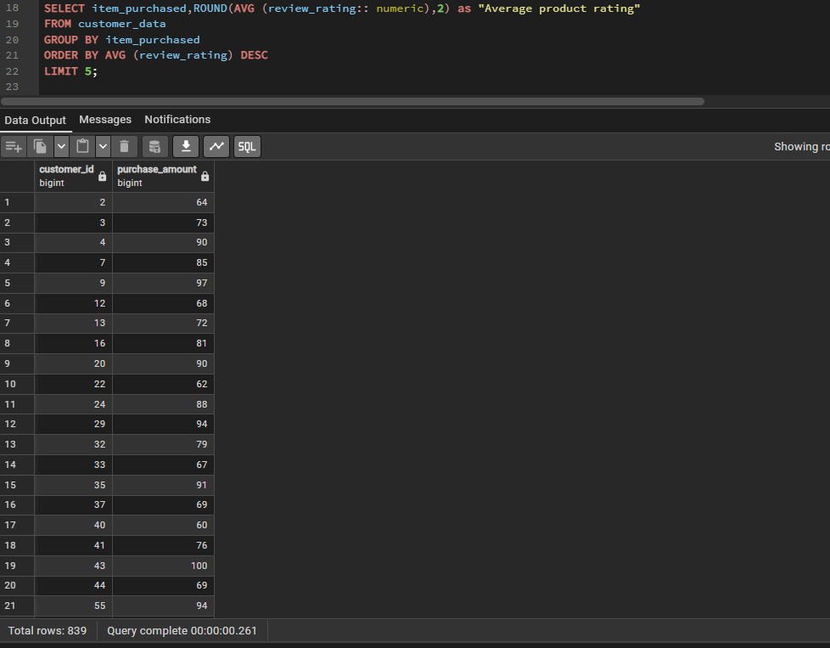
Key SQL Analysis: Business Transactions
Top 5 Products by Rating
Highlighting the most popular and well-received products.
M.H.R. Perera | Customer Shopping Behavior Analysis

Slide 11
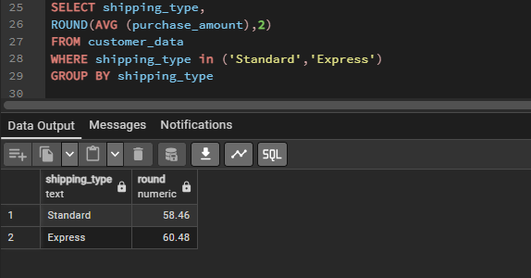
Key SQL Analysis: Business Transactions
Shipping Type Comparison
Analyzing the impact of different shipping methods on customer behavior.
M.H.R. Perera | Customer Shopping Behavior Analysis

Slide 12
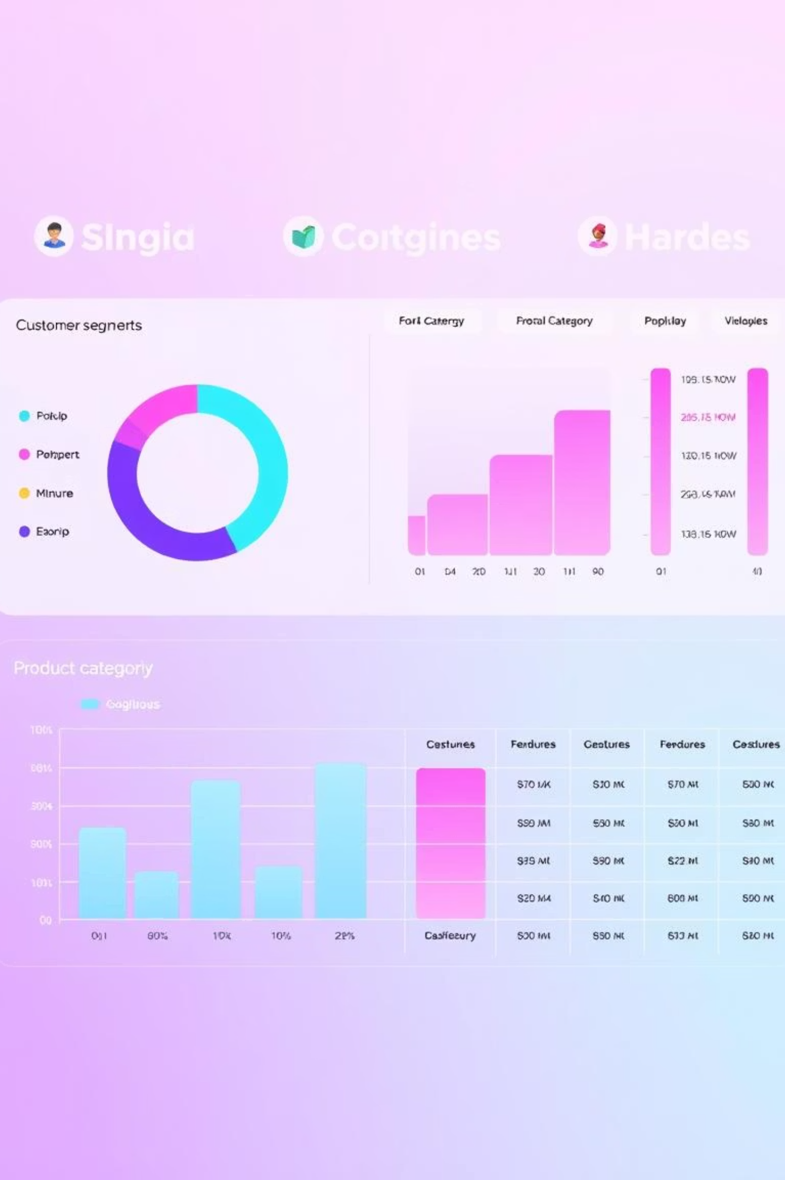
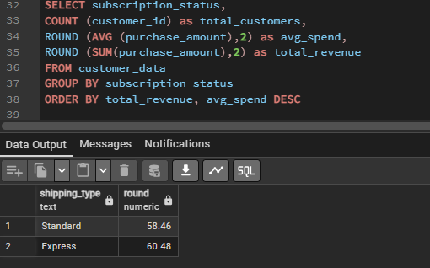
Deeper Dive: SQL Insights
Further SQL analysis revealed intricate patterns in subscription behavior, discount dependency, and customer segmentation.
Subscribers vs. Non-Subscribers
Comparing purchase behaviors and revenue contributions.
M.H.R. Perera | Customer Shopping Behavior Analysis

Slide 13
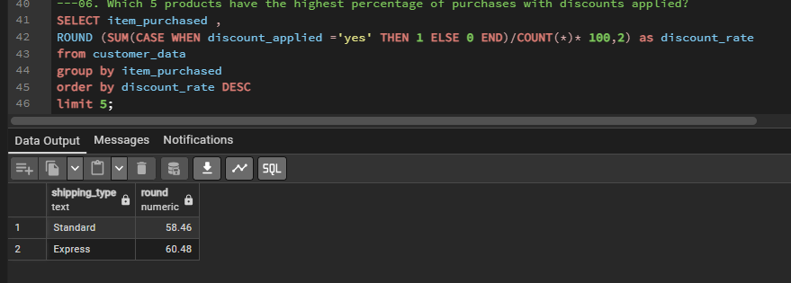
Deeper Dive: SQL Insights
Discount-Dependent Products
Identifying products whose sales are heavily influenced by discounts.
M.H.R. Perera | Customer Shopping Behavior Analysis

Slide 14
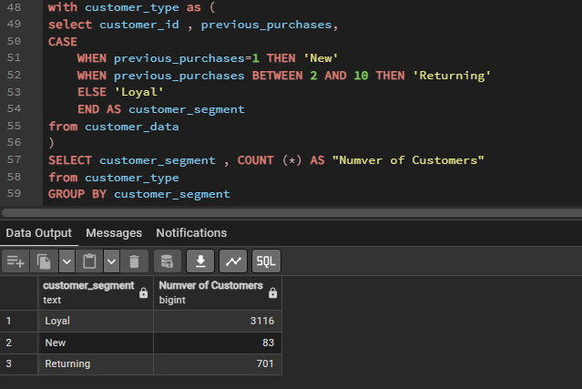
Deeper Dive: SQL Insights
Customer Segmentation
Grouping customers based on shared characteristics and behaviors.
M.H.R. Perera | Customer Shopping Behavior Analysis

Slide 15
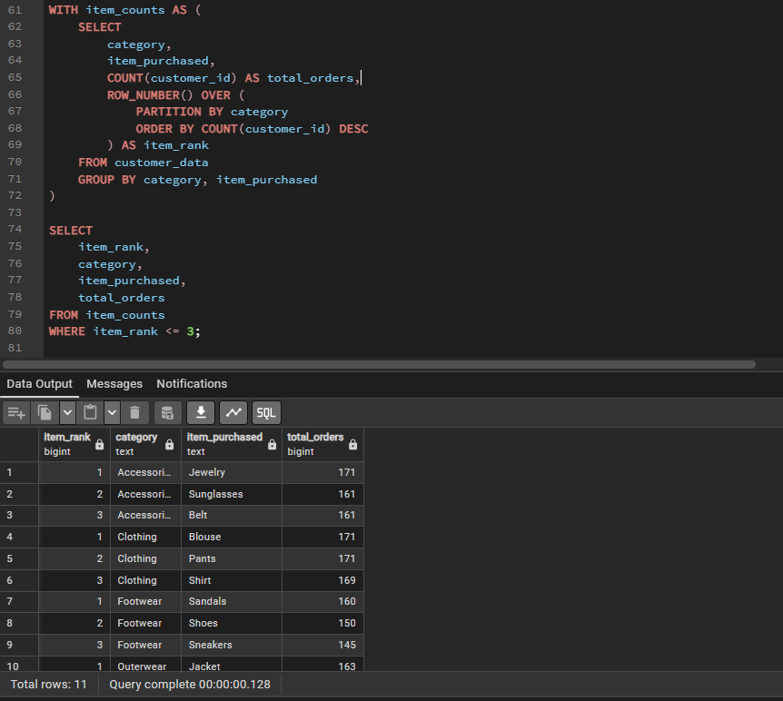
Deeper Dive: SQL Insights
Top 3 Products per Category
Pinpointing best-selling items within each product category.
M.H.R. Perera | Customer Shopping Behavior Analysis

Slide 16
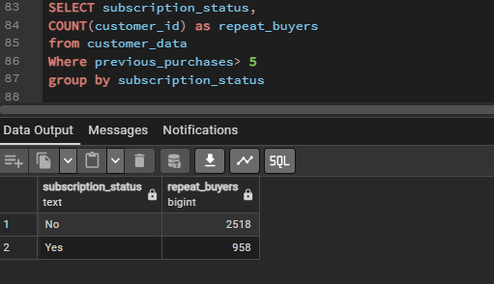
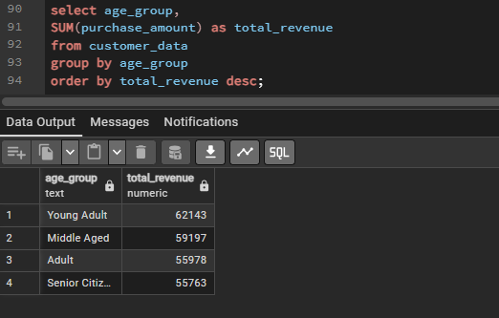
Unveiling Customer Loyalty and Revenue Trends
Our SQL analysis also focused on understanding repeat buyers, subscription likelihood, and revenue distribution across different age groups.
Repeat Buyers & Subscription Likelihood
Examining factors that drive customer retention and subscription conversions.
Revenue by Age Group
Identifying the most valuable age demographics for targeted marketing.
M.H.R. Perera | Customer Shopping Behavior Analysis

Slide 17
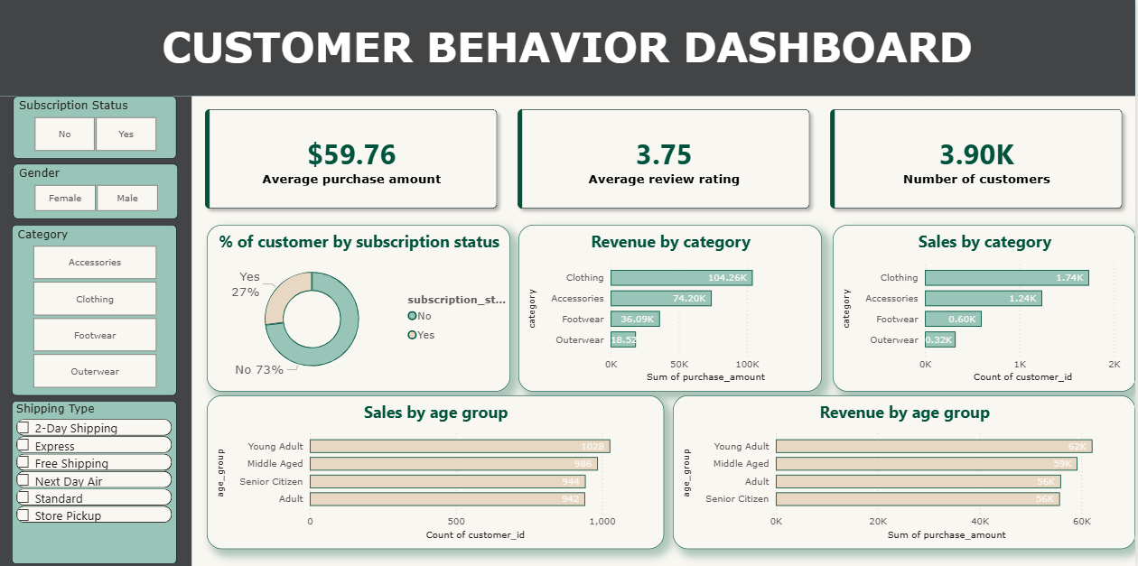
Interactive Dashboard in Power BI
The Power BI dashboard provides an interactive and comprehensive view of our findings, enabling stakeholders to explore data visually.
Customer Demographics
Visualizing age, gender, and location distributions.
Revenue Patterns
Tracking sales trends and high-performing segments.
Purchase Category Trends
Identifying popular product categories.
Subscription Impacts
Analyzing the value of subscribed customers.
M.H.R. Perera | Customer Shopping Behavior Analysis
Seasonal Behavior Insights: Understanding purchasing habits throughout the year.

Slide 18




Strategic Business Recommendations
Based on our comprehensive analysis, we propose several key recommendations to optimize business strategies and enhance customer engagement.
Boost Subscriptions
Customer Loyalty Programs
Offer exclusive perks to incentivize new sign-ups and retain existing subscribers.
Implement programs to reward repeat customers and foster long-term relationships.
Review Discount Policies
Highlight Top-Rated Products
Strategically adjust discount offerings to protect margins while attracting customers.
Promote highly-rated items to leverage social proof and drive sales.
M.H.R. Perera | Customer Shopping Behavior Analysis

Slide 19


Targeted Growth Opportunities
Focusing on specific customer segments and service preferences can unlock significant growth potential.
Target High-Value Age Groups
Optimize Express Shipping
Tailor marketing campaigns and product offerings to demographics with the highest revenue contribution.
Enhance services for users who prefer express shipping, potentially offering premium options or loyalty benefits.
By implementing these recommendations, businesses can make data-driven decisions that lead to increased revenue, improved customer satisfaction, and sustainable growth.
M.H.R. Perera | Customer Shopping Behavior Analysis

